Slide 1

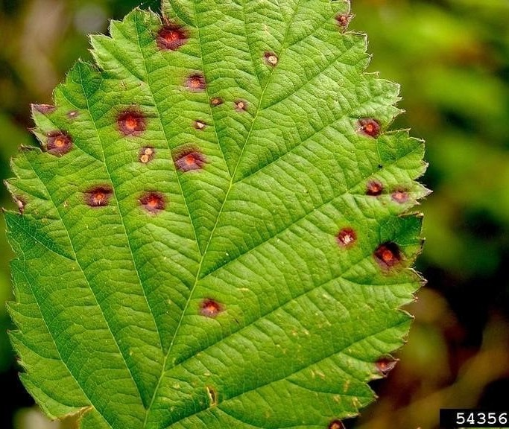
Foliar Disease Deĺecĺion Sysĺem
Machine learning algorithms analyze daĺa paĺĺerns from various sources to predict and identify foliar diseases. By leveraging big daĺa, farmers can make informed decisions and optimize disease management strategies.
Mentor : Prof. Kamal Kant Sharma

Slide 2

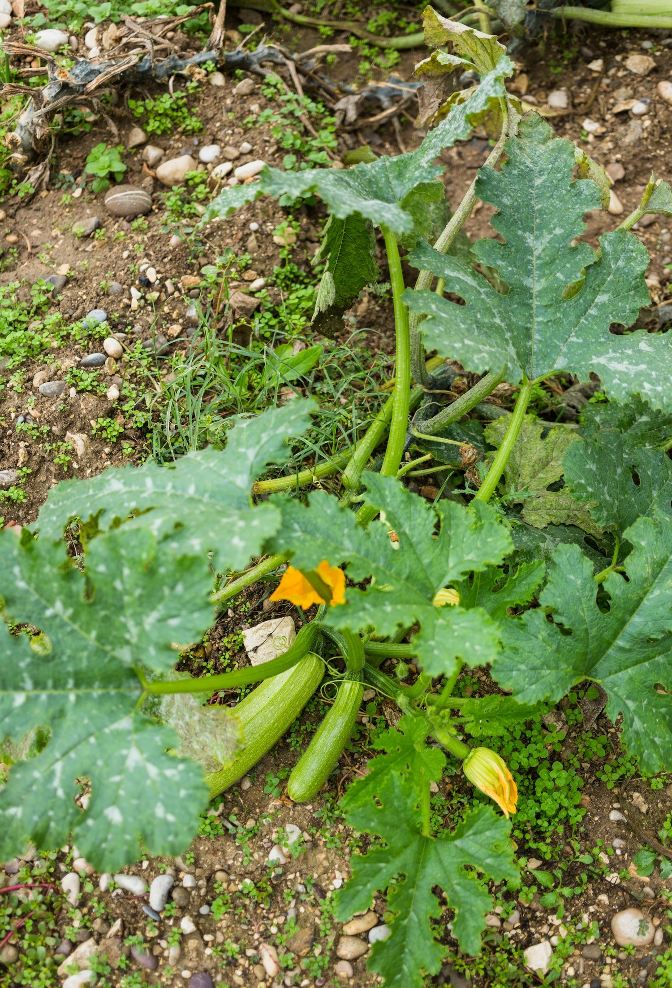
Introduction to Foliar Diseases
Plant diseases cause signiﬁcant yield losses (13% of crops). Approximately 20% to 40% of global food output is lost due to these diseases.
Image processing, combined with AI, can e ectively identify plant diseases.
Analysis of leaf images is key to accurate diagnosis.Analysis of leaf images is key to accurate diagnosis.
Fungal diseases contribute to up to 50% of total yield losses.
Early detection is crucial for managing and preventing disease spread.
E ective management can optimize pesticide application and enhance crop health.

Slide 3

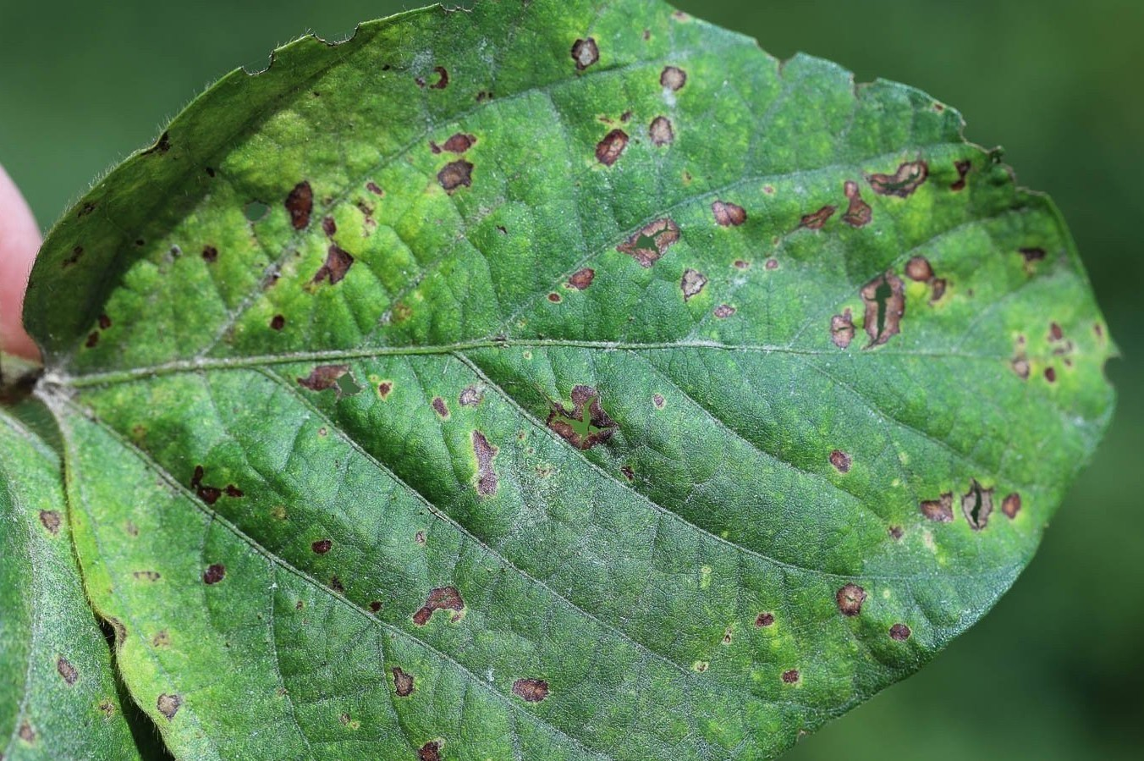
Problem Statement : -
Current Situation: Farmers rely on manual, inaccurate methods for
detecting foliar diseases.
Problem Description: Lack of automated tools leads to delays in identifying plant diseases.
Impact of the Problem: Delayed detection results in crop losses and improper treatments.
esired Outcome: Develop a system for real-time, accurate detection of
plant diseases.

Slide 4
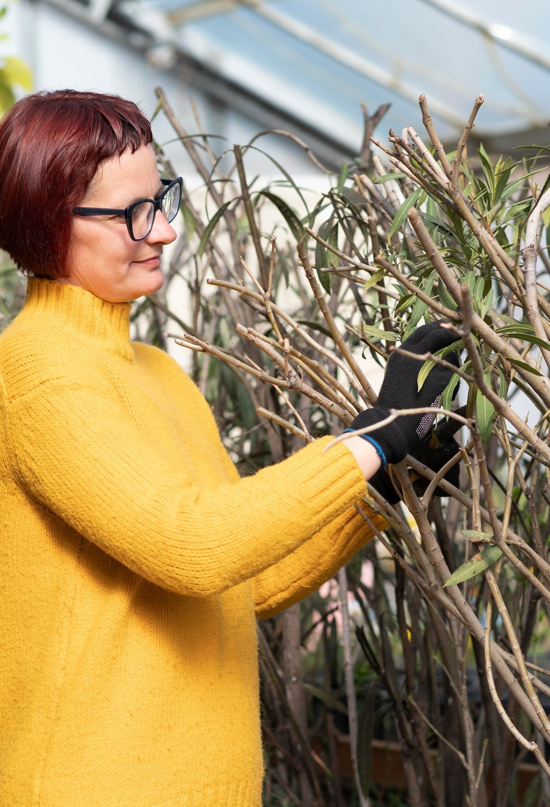
Proposed Methodology
Data Collection Data Processing Feature Extraction Model Deployment Model Evaluation
Feedback and Improvement Documentation and Reporting

Slide 5
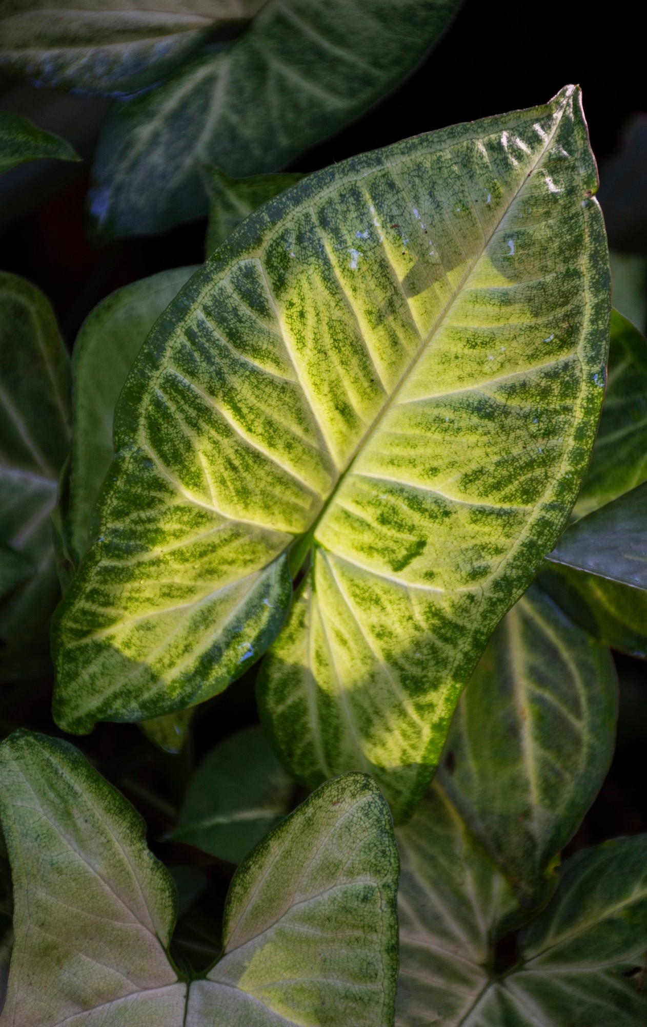
Understanding Foliar Diseases
Foliar diseases are caused by pathogens like fungi, bacteria, and viruses that infect plant leaves, leading to reduced photosynthesis.
Recognizing the sympĺoms early is crucial for
e ective management and minimizing economic losses.

Slide 6



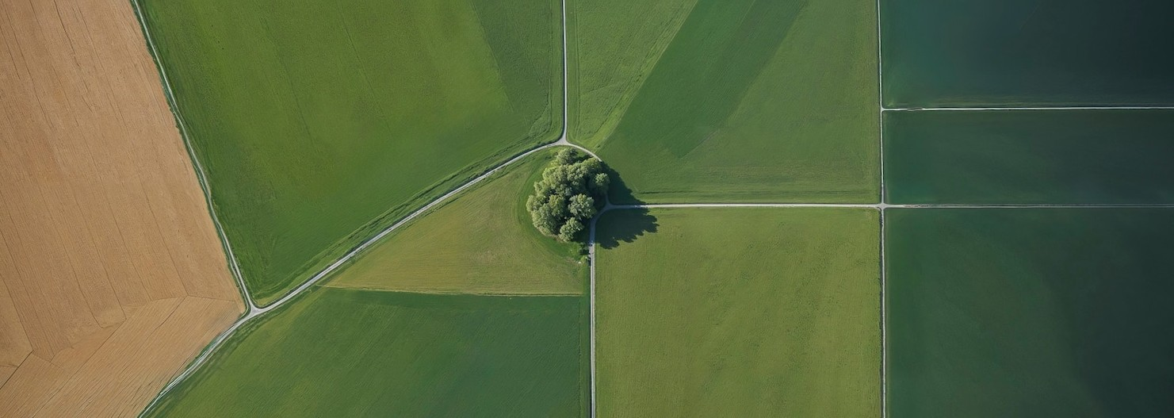
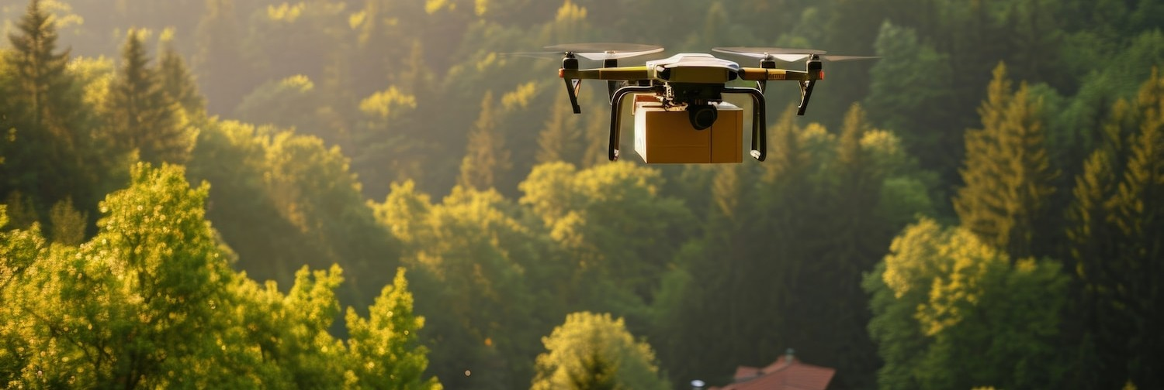
Remote Sensing Technologies
Remote sensing uses satellite imagery and drones to monitor crop health over large areas. These technologies help in identifying stress symptoms caused by foliar diseases, allowing for targeted interventions and resource allocation.

Slide 7


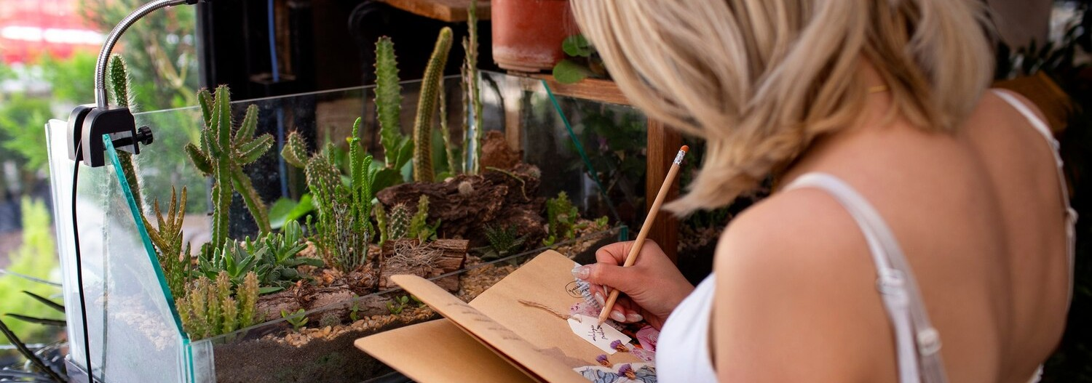
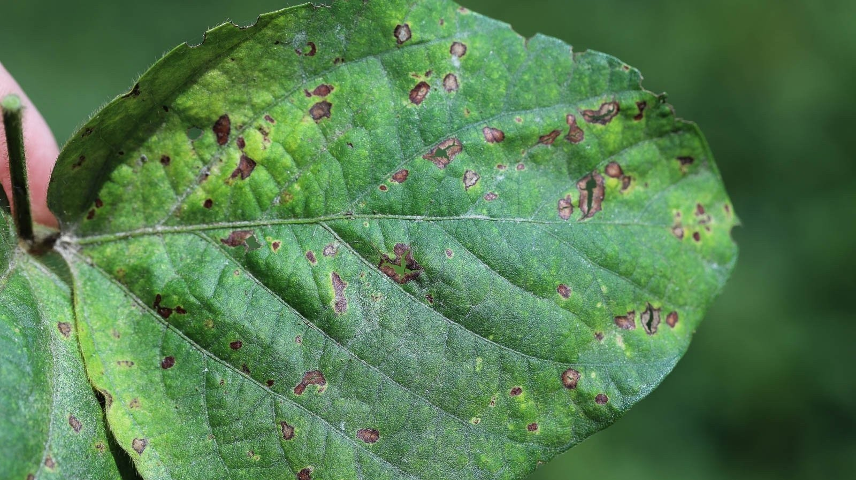
Image Processing Techniques
Advanced image processing techniques, such as spectral analysis, can enhance the detection of foliar diseases. These methods improve the accuracy of disease identiﬁcation through visual data analysis, reducing reliance on manual inspections.

Slide 8


Field Sensors and IoT
Integrating ﬁeld sensors and the Internet of Things (IoT) enables real-time monitoring of environmental conditions that a ect plant health. This data provides insights into potential disease outbreaks, allowing for proactive management.

Slide 9


Case Studies in Innovation
Several case studies illustrate the successful application of innovative technologies in foliar disease detection. These examples highlight the e ectiveness of combining traditional methods with modern technology for enhanced agricultural health.

Slide 10



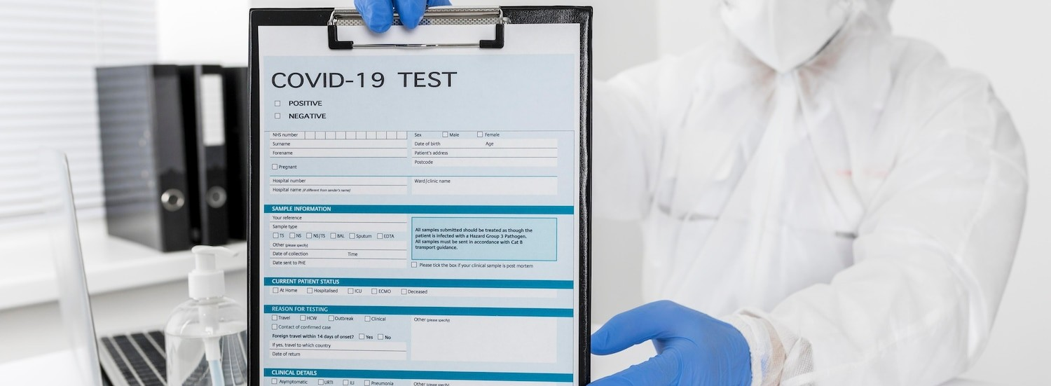
Challenges in Detection
Despite advancements, challenges remain in the detection of foliar diseases. Factors such as data variability, environmental conditions, and the complexity of disease symptoms can hinder accurate identiﬁcation and timely intervention.

Slide 11

Future Directions
The future of foliar disease detection lies in integrating AI, machine learning, and improved sensor technologies.
Continued research and development will enhance the accuracy and e ciency of disease monitoring in agriculture.

Slide 12



Best Practices for Farmers
Farmers can adopt best practices such as regular monitoring, utilizing technology for early detection, and integrating crop management strategies to minimize the impact of foliar diseases on their crops.

Slide 13

Conclusion
In conclusion, advanced foliar disease detection technologies are crucial for sustainable agricultural health monitoring. By embracing innovation, farmers can enhance crop resilience and ensure food security for the future.

Slide 14
Thanks!

